Slide 1
Limitations of AI in HDR study
Yongze Song
School of Design and the Built Environment
Curtin University
15 September 2025

Slide 2

Introduction
PhD students' research and study emphasizes originality, depth, and critical thinking
AI is increasingly used in research (writing, literature search, data analysis)
Question: what are limitations of AI in research and study?
(Source: Google image)

Slide 3
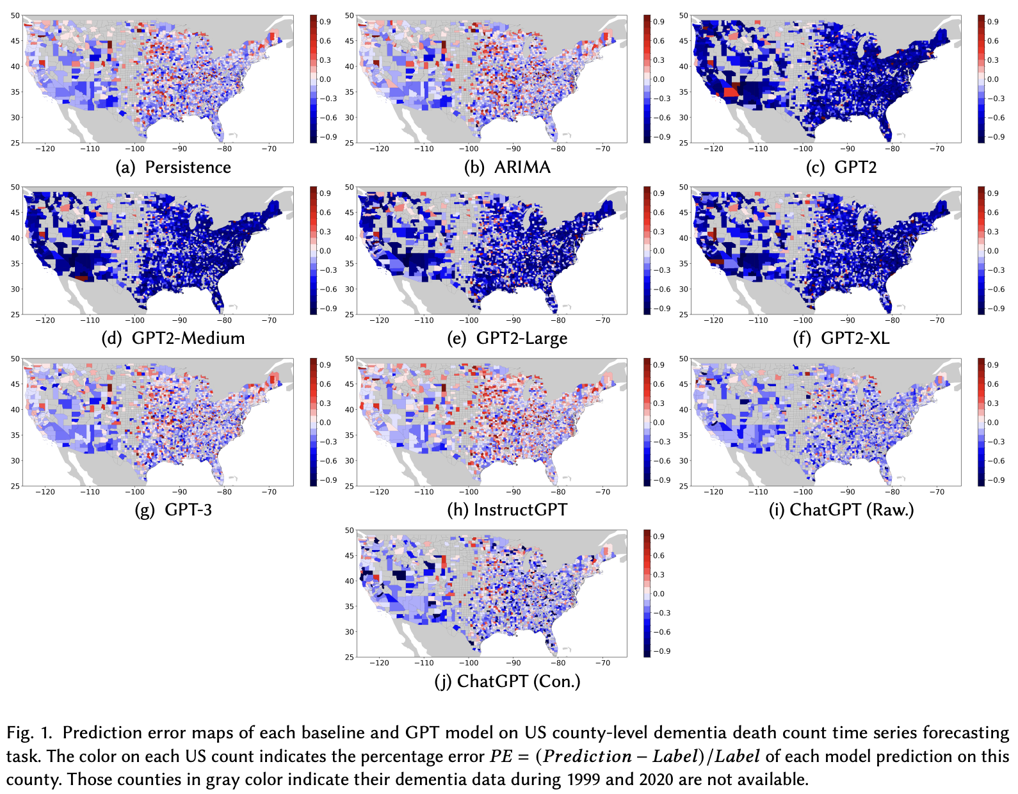
AI advantages
Examples in built environment research
Helps improve language quality
Assists in improving research efficiency
Quickly integrates information from literature
  AI can help design, manage, and optimise green infrastructure (GI) for cooling and water management (Shaamala 2024)
Recognizes patterns and processes data
  Foundation models can be used in both text-only geospatial tasks (e.g., location recognition, health forecasting) and multimodal tasks (e.g., urban function, noise, remote sensing) (Mai 2023)
(Mai 2023)

Slide 4
AI vs. Hunman intelligence
Aspect | AI | Human Intelligence
Data processing | Fast with large datasets | Slower, but flexible
Creativity | Limited, follows programmed rules | High creativity
Understanding context | Hard to capture small differences | Strong contextual understanding
Ethics | Lacks emotional intelligence | Strong ethical sense
Decision making | Based on algorithms and data | Uses judgment and experience

Slide 5
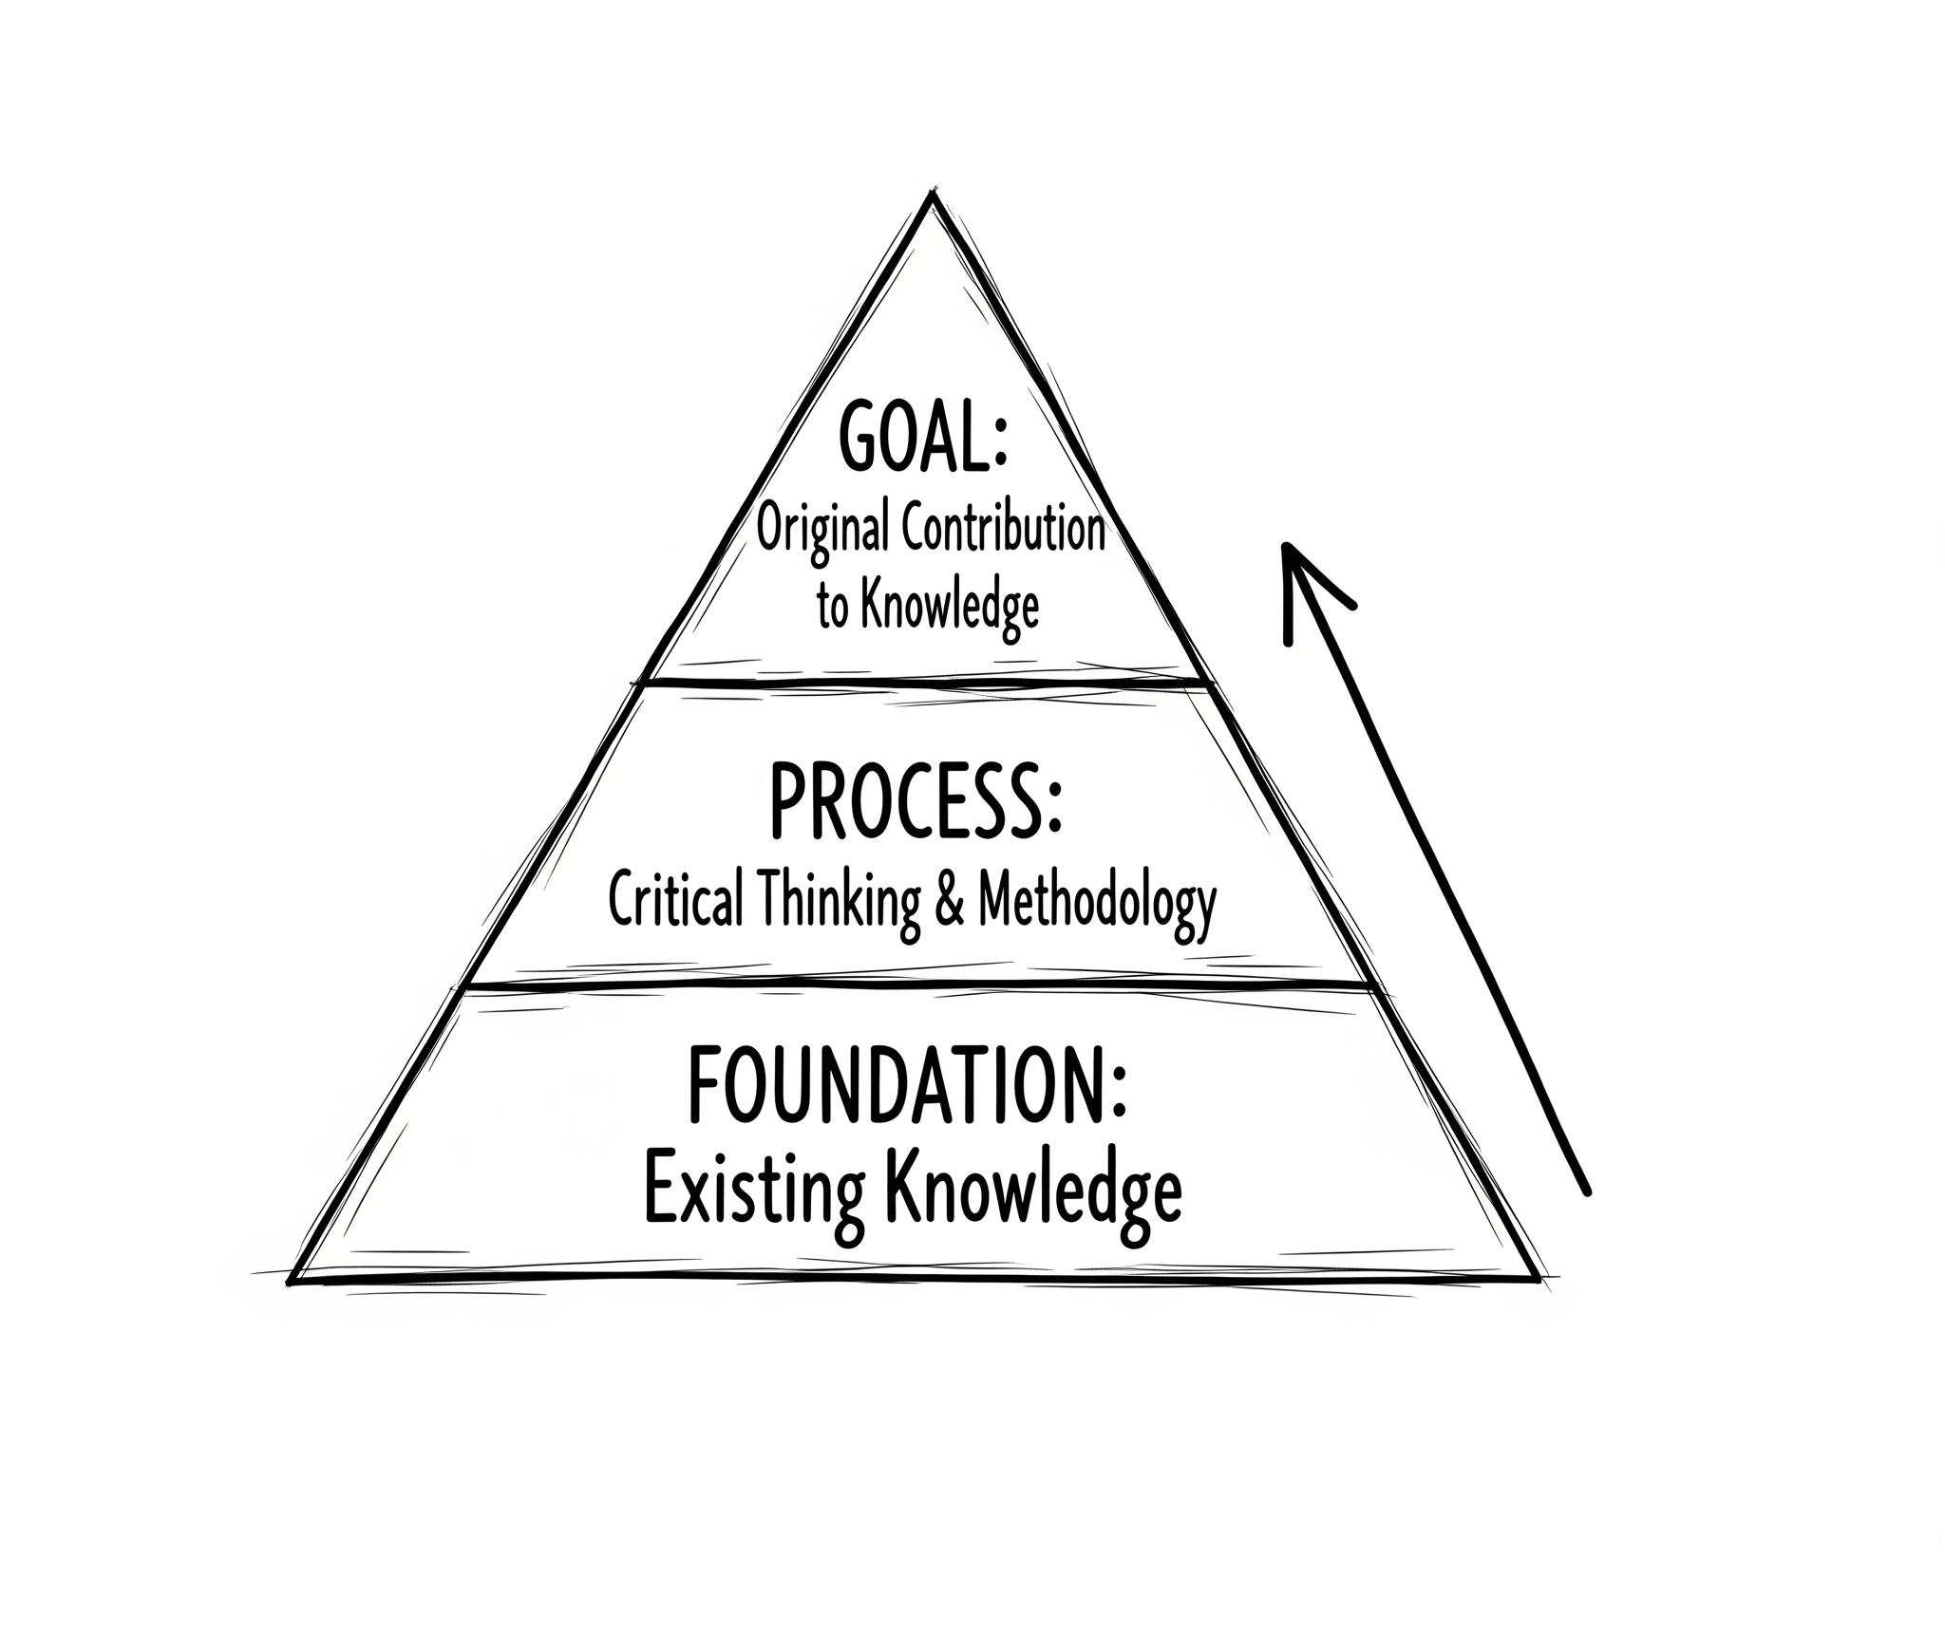
Key values of PhD research
Propose original research questions
Develop critical thinking
Build theoretical and methodological models
Advance the frontiers of knowledge
Follows ethical and academic integrity requirements
AI has limitations in these aspects

Slide 6
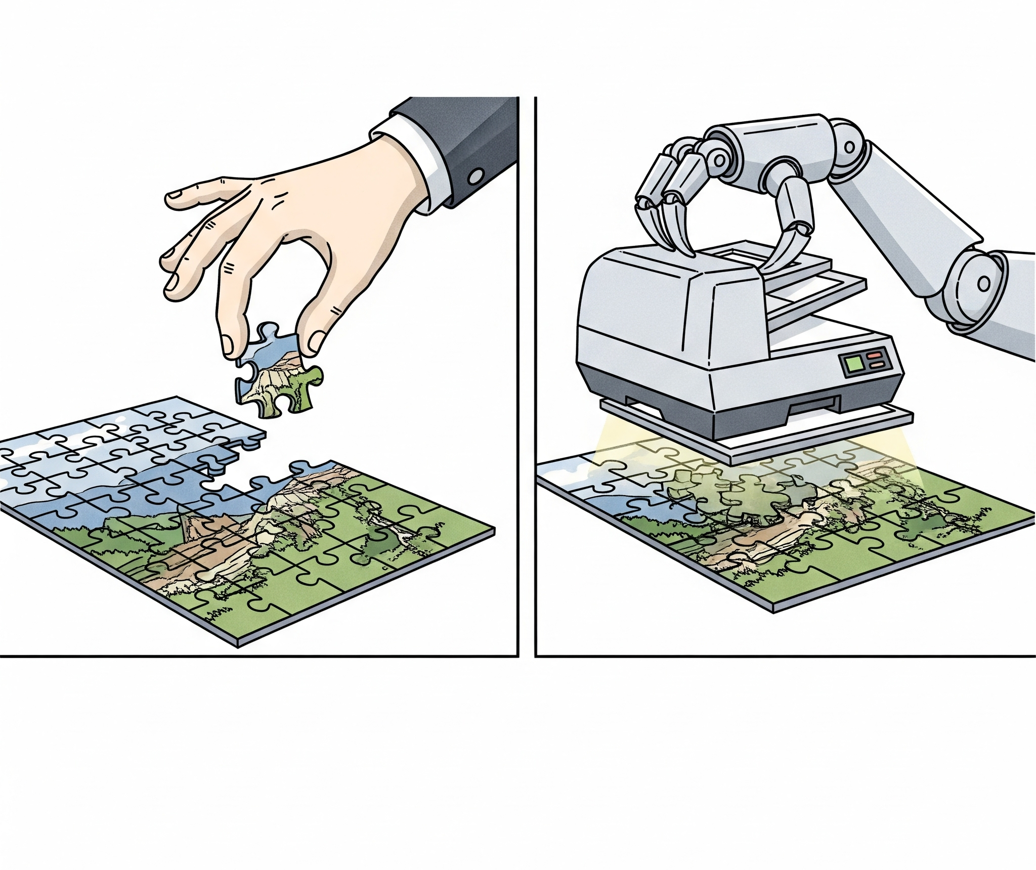
Limitation 1 – Lack of Original Research Ability
Relies on existing data and patterns; hard to propose new questions
Cannot autonomously identify research gaps
More about summarizing than innovating

Slide 7
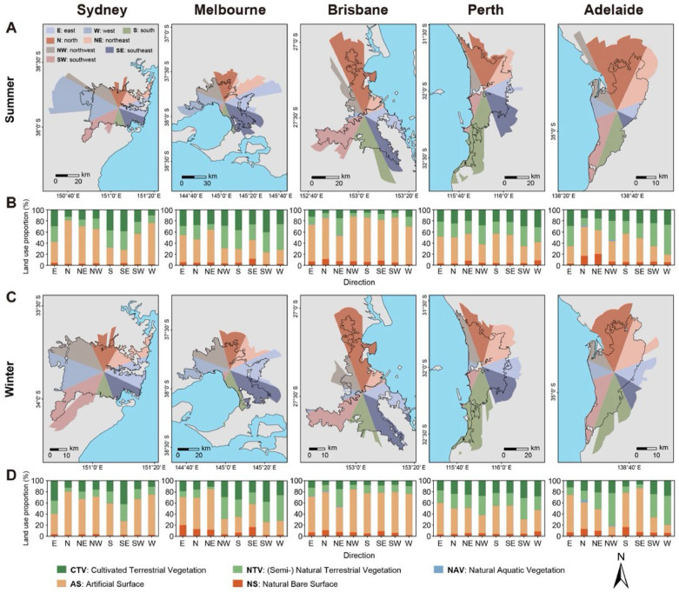
Limitation 1 – Lack of Original Research Ability
Case: Urban Heat Island (UHI) Mitigation Studies
What AI can do well
  Predicts and maps UHI patterns from satellite and land-use data
  Recognizes links (e.g., tree canopy → cooling effects, dense built-up → hotspots)
  Efficient at summarising existing relationships
Where AI can’t do well
  Relies on existing datasets and predefined questions
  Cannot autonomously propose new research questions
Researchers’ contributions
  Novel research gaps identified by scholars, e.g.
    Irregular anisotropy in urban heat footprints (Yang et al., 2025)
    Urban heat vulnerability analysis and assessment of cooling strategies (Li et al., 2024)
AI enhances efficiency in summarising data, but innovation in identifying new questions from practice for sustainable cities depends on researchers.
(Yang 2025)

Slide 8
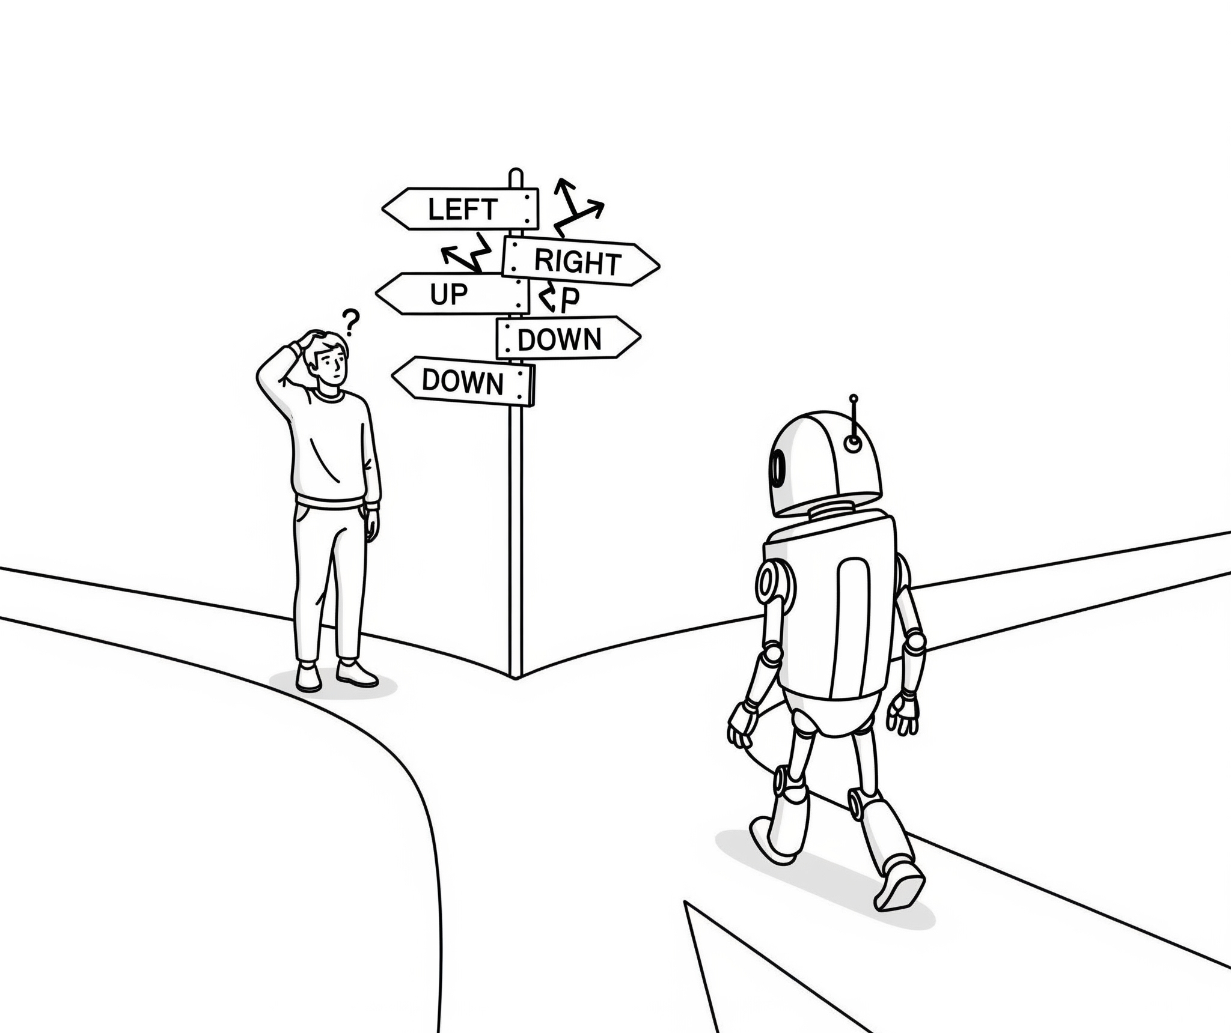
Limitation 2 – Lack of Critical Thinking and Creativity
Cannot actively challenge or refute ideas
Tends to generate “plausible-looking” text
Tends to follow mainstream perspectives, ignoring alternative or marginalised views.
Limited ability to handle academic debates or deep logic

Slide 9
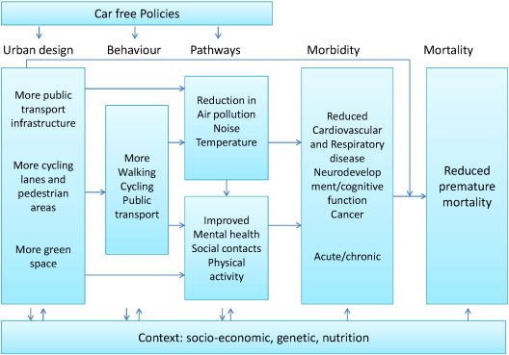
Limitation 2 – Lack of Critical Thinking and Creativity
Case: Sustainable transport and mobility planning
What AI can do well
  Summarizes mainstream solutions (e.g., AI for mobility studies using big data, expand public transit, adopt electric vehicles)
  Reinforces existing narratives without questioning assumptions
Where AI can’t do well
  Challenge existing ideas
  Engage in academic debates
Researchers’ contributions
  Car-free cities have potential to reduce pollution, enhance public health, and support climate mitigation (Nieuwenhuijsen 2016)
  Hamburg, Oslo, Helsinki, and Madrid have recently announced their plans to become (partly) private car free cities.
  Other cities like Paris, Milan, Chengdu, Masdar, Dublin, Brussels, Copenhagen, Bogota, and Hyderabad have measures that aim at reducing motorized traffic including implementing car free days.
(Nieuwenhuijsen 2016)

Slide 10
Limitation 3 – Insufficient Disciplinary Depth & Judgment
Limited understanding of interdisciplinary complexity
Lacks sensitivity to disciplinary traditions and theory evolution
Cannot replace human judgment in fieldwork or experimental design

Slide 11
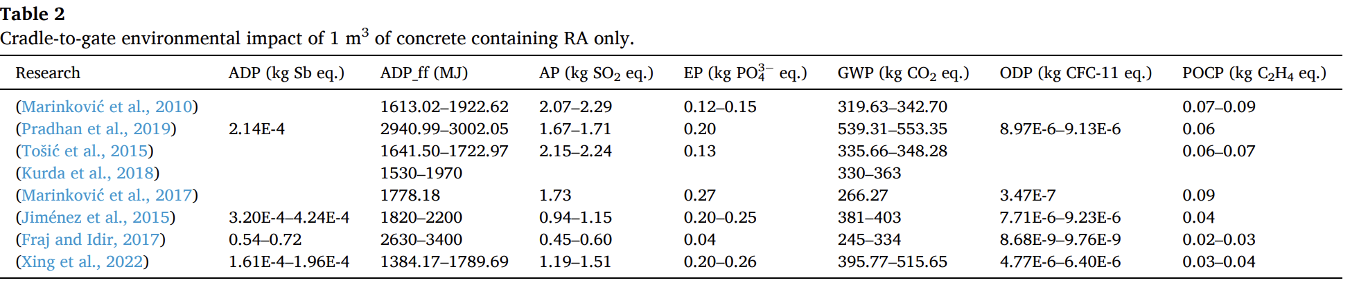
Limitation 3 – Insufficient Disciplinary Depth & Judgment
Case: Life cycle assessment (LCA) in sustainable building design
What AI can do well
  Automates large-scale data processing (materials, energy, carbon factors)
  Quickly generates life cycle carbon or energy estimates
Where AI can’t do well
  Lacks disciplinary variations in LCA theory
  Misses interdisciplinary judgment across engineering, environmental science, and social contexts
Researchers’ contributions
  LCA of waste-integrated concrete bricks and roof tiles requires expert judgment in allocation methods, waste material qualification, and system boundary choices (Patrisia 2025)
  LCAs on recycled versus natural aggregate concrete needs expert judgment in defining functional units, system boundaries, allocation rules, and durability considerations (Xing 2023)

Slide 12
Limitation 4 – Misinformation
Generates plausible but incorrect or fabricated responses.
Cannot fact-check like humans, making it prone to spreading errors.
References often (always) contain mistakes (authors, dates, titles), lowering reliability.

Slide 13
Limitation 5 – Ethical and Academic Integrity Issues
May produce false citations or risk plagiarism
Misuse of AI can threaten research quality and integrity

Slide 14
Conclusion and takeaways
AI is a tool, not a substitute
HDR research needs independent thinking and innovation
AI can efficiently summarise existing data, but professional experience, disciplinary depth, and researchers’ judgment remain irreplaceable in urban and sustainability research, such as proposing new questions in urban heat island studies, challenging paradigms in sustainable transport planning, and making decisions in life cycle assessment of building materials.
(Yang 2025)

Slide 15
Reference
Shaamala, A., Yigitcanlar, T., Nili, A., & Nyandega, D. (2024). Algorithmic green infrastructure optimisation: Review of artificial intelligence driven approaches for tackling climate change. Sustainable Cities and Society, 101, 105182. https://doi.org/10.1016/j.scs.2024.105182 ￼
Mai, G., Huang, W., Sun, J., Song, S., Mishra, D., Liu, N., Gao, S., Liu, T., Cong, G., Hu, Y., Cundy, C., Li, Z., Zhu, R., & Lao, N. (2023). On the opportunities and challenges of foundation models for geospatial artificial intelligence. arXiv preprint arXiv:2304.06798. ￼
Li, F., Yigitcanlar, T., Nepal, M., Nguyen Thanh, K., & Dur, F. (2024). A novel urban heat vulnerability analysis: Integrating machine learning and remote sensing for enhanced insights. Remote Sensing, 16(16), 3032. https://doi.org/10.3390/rs16163032 ￼
Yang, X., Song, Y., Yoo, C., Ren, K., & Wu, P. (2025). Irregular anisotropy in surface urban heat island footprint. Sustainable Cities and Society, 106779 (early access/article number). https://doi.org/10.1016/j.scs.2025.106779 (article record) ￼
Nieuwenhuijsen, M. J., & Khreis, H. (2016). Car free cities: Pathway to healthy urban living. Environment International, 94, 251–262. https://doi.org/10.1016/j.envint.2016.05.032 ￼
Patrisia, Y., Law, D. W., Gunasekara, C., & Setunge, S. (2025). Assessment of waste-integrated concrete products: A cradle-to-cradle perspective. The International Journal of Life Cycle Assessment, 30, 834–861. https://doi.org/10.1007/s11367-025-02443-w ￼
Xing, W., Tam, V. W. Y., Le, K. N., Hao, J. L., & Wang, J. (2023). Life cycle assessment of sustainable concrete with recycled aggregate and supplementary cementitious materials. Resources, Conservation and Recycling, 193, 106947. https://doi.org/10.1016/j.resconrec.2023.106947 ￼

